Slide 1
Chapter 1 Algorithms with Numbers

Slide 2
Bases and logs
The largest number with k digits in base b is b^{k}-1: 999=10³-1.
In base b, to write N, digits are needed.
In base a, as , times digits are needed.
In big-O notation, the base is irrelevant, and we write the size of N simply as O(log N).
log N
the power to which you need to raise 2 in order to obtain N ( )
the number of times you must halve N to get down to 1 ( )
the number of bits in the binary representation of N ( )
the depth of a complete binary tree with N nodes

Slide 3
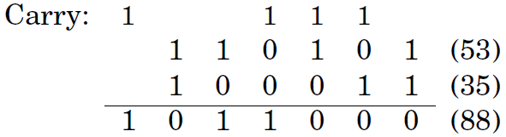
Addition
The sum of any three single-digit numbers is at most two digits long.
53+35 in binary
Time complexity: O(n).
Is there a faster algorithm? No!
The ADD instruction?

Slide 4
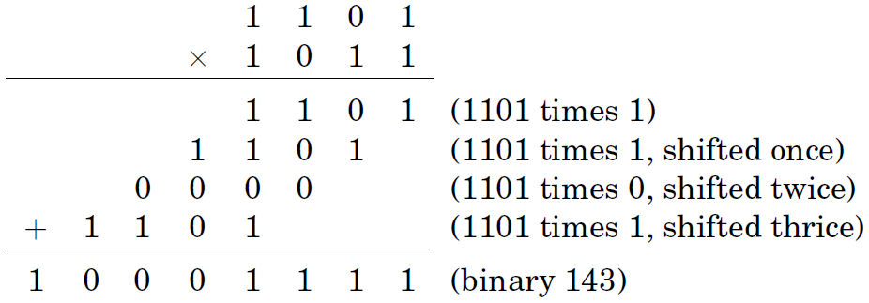

Multiplication
Standard Algorithm:
Time complexity: O(n²)

Slide 5
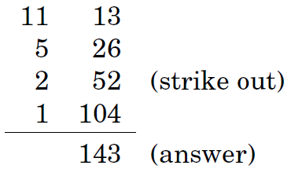
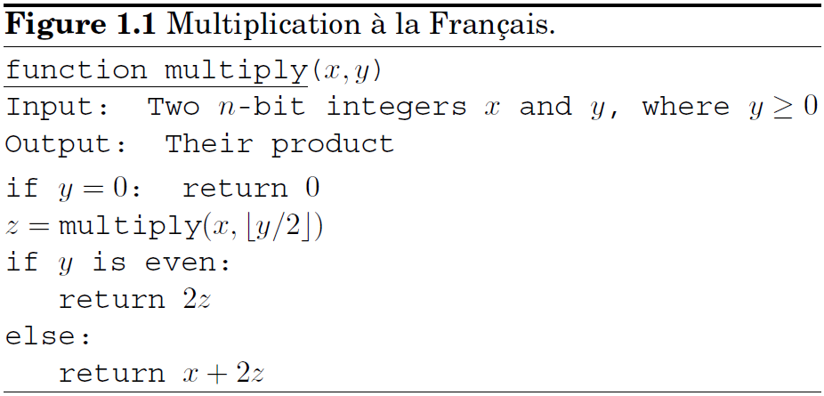
Multiplication
Al Khwarizmi Algotihm:
Recursive algorithm:
Time complexity: O(n²)
Can we do better? Intuitively, No. But, Yes! Chapter 2

Slide 6
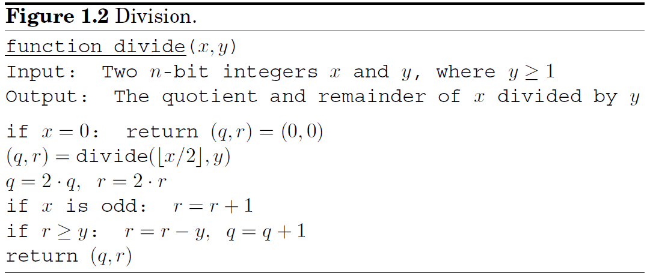
Division
Time complexity: O(n²)
To divide an integer x by another integer means to find a quotient
q and a remainder r, where x = yq + r and r < y.
return (q, r). How much time?

Slide 7
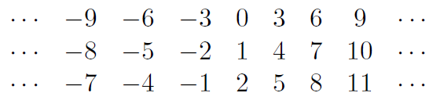
Modular Arithmetic
x and y are congruent modulo N:
Complete residue system modulo N:
{0,1,2,…,N-1}
Additive abelian group
Multiplicative commutative monoid(含幺半群)
Distributive law
If N is a prime number, then the residue system is a domain！
Substitution rule: if and
then and

Slide 8
Modular Addition, Modular Multiplication
Modular Addition: O(n).
Modular Multiplication: O(n²).
Modular Division: O( ? ).

Slide 9
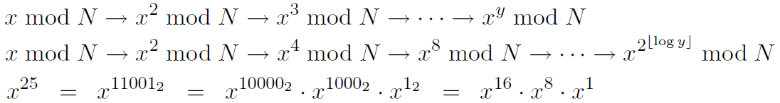
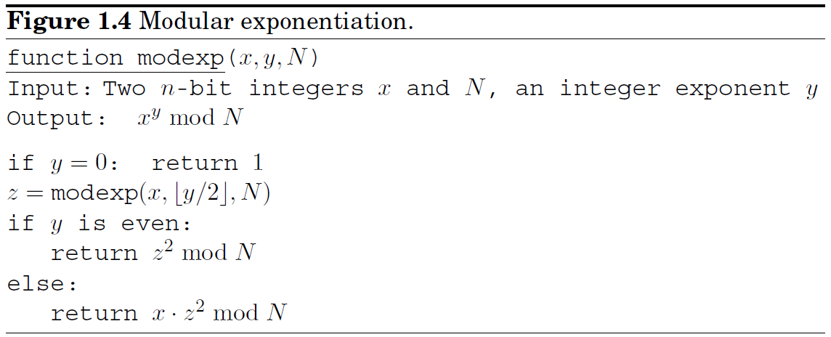
Modular Exponentiation
x^{y} mod N：the result < N, but x^{y} can be very large.
Time complexity: O(n³)

Slide 10
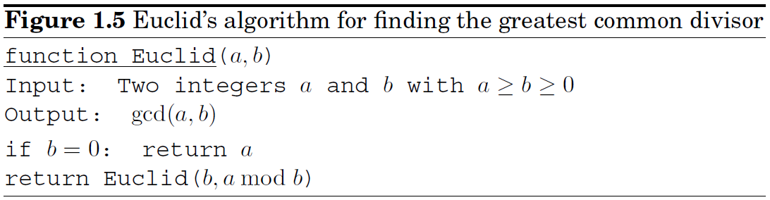
Greatest Common Divisor
Euclid’s rule:
Euclid’s algorithm:
Time complexity: O(n³) ？
if b=0; return a; How much time?

Slide 11
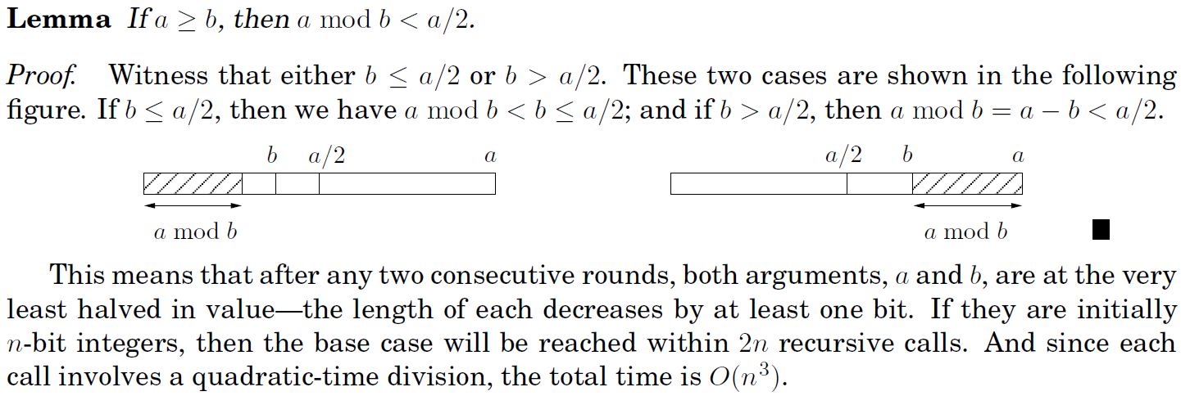
Greatest Common Divisor
The correctness of Euclid’s algorithm follows immediately from Euclid’s rule. In order to figure out its running time, we need to understand how quickly the arguments (a, b) decrease with each successive recursive call. In a single round, arguments (a, b) become (b, a mod b): their order is swapped, and the larger of them, a, gets reduced to a mod b.

Slide 12
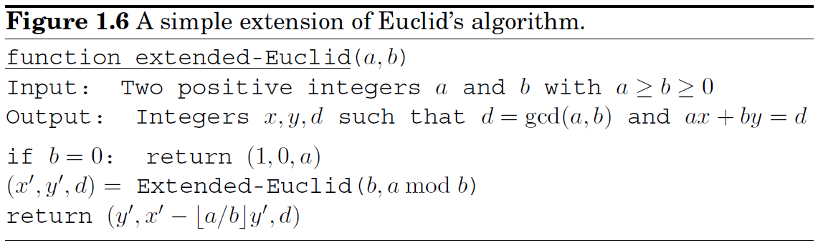
An Extension of Euclid's Algorithm
A property of GCD:
Lemma: If d divides both a and b, and d = ax + by for some integers x and y, then necessarily d = gcd(a, b).
Proof. Since d is a common divisor of a and b and so it cannot exceed the greatest common divisor; that is, . On the other hand, since gcd(a, b) is a common divisor of a and b, it must also divide ax + by = d, which implies . So, d = gcd(a, b).
Extended Euclid Algorithm:

Slide 13
An Extension of Euclid's Algorithm
Lemma: For any positive integers a and b, the extended Euclid algorithm returns integers x, y, and d such that gcd(a, b) = d = ax + by.
Proof. If you ignore the x's and y's, the extended algorithm is the same as the original. So, at least we get d = gcd(a, b).
The recursive nature of the algorithm suggests a proof by induction. The recursion ends when b = 0, so it is convenient to do induction on b.
The base case b = 0 is easy to check directly. Pick any larger value of b. The algorithm finds gcd(a, b) by calling gcd(b, a mod b). Since a mod b < b, we can apply the inductive hypothesis to this recursive call and conclude that the x' and y' it returns are correct: gcd(b, a mod b) = bx' + (a mod b)y'. Since , we find
Therefore d = ax + by with x = y' and , thus validating the algorithm's behavior on input (a, b).

Slide 14
Modular Division
In real arithmetic, every number has an inverse, 1/a, and dividing by a is the same as multiplying by this inverse. In modular arithmetic, we say
x is the multiplicative inverse of a modulo N if .
There can be at most one such x, and denote it by a⁻¹. But this inverse does not always exist!
When gcd(a, N) = 1 (we say a and N are relatively prime), the extended Euclid algorithm gives us integers x and y such that ax + Ny = 1, which means that . Thus x is a's inverse.

Slide 15
Modular Division
Example. We wish to compute 11⁻¹ (mod 25).
Using the extended Euclid algorithm, we find that 15·25-34·11 = 1. Reducing both sides modulo 25, we have . So is the inverse of 11 (mod 25).
Modular division theorem. For any a mod N, a has a multiplicative inverse modulo N if and only if it is relatively prime to N. When this inverse exists, it can be found in time O(n³) (where as usual n denotes the number of bits of N) by running the extended Euclid algorithm.

Slide 16
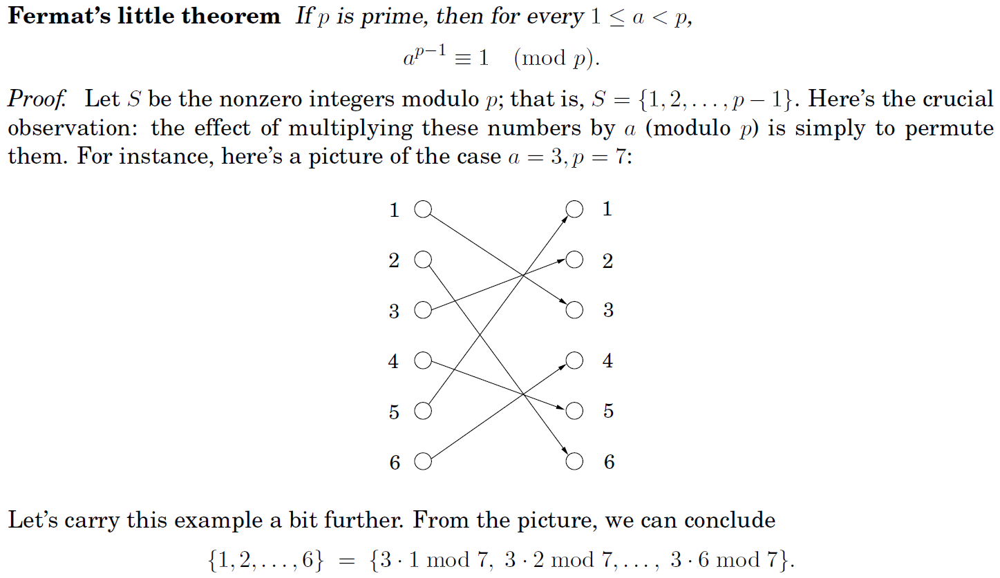
Primality Testing
Can we decide whether a number is prime without actually trying to factor the number?

Slide 17
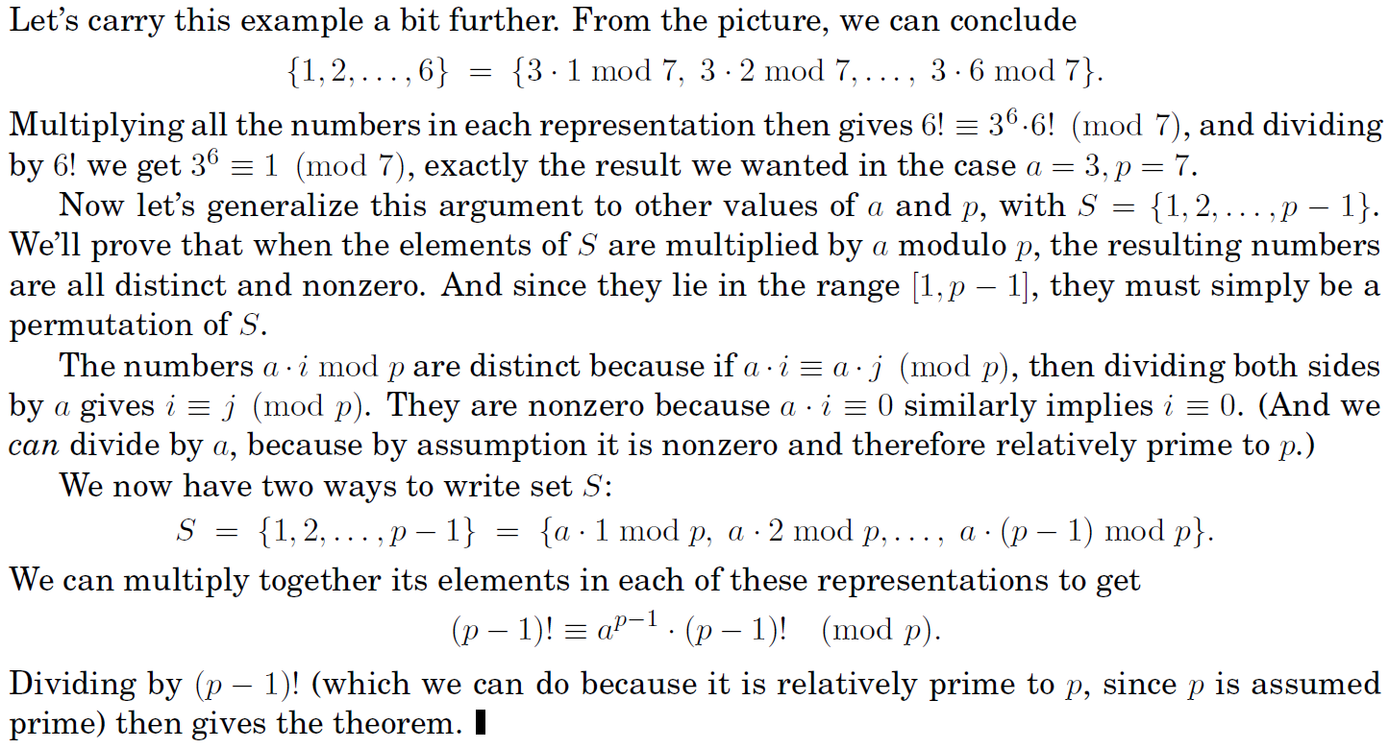
Primality Testing
When a ≥ p?

Slide 18
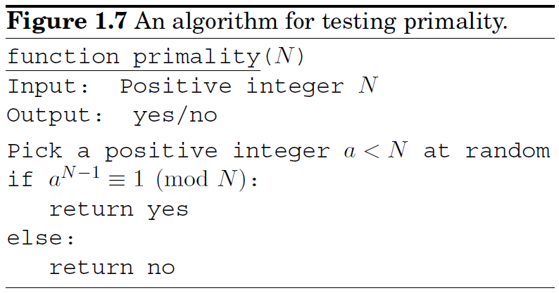
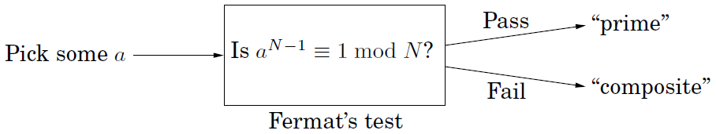
Primality Testing
If N is a prime number, it can pass Fermat's test.
If N is a composite number, it can pass Fermat's test with some probability.

Slide 19
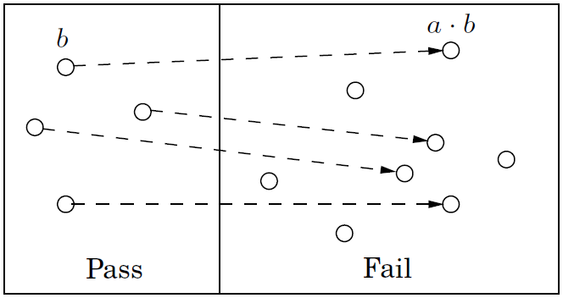
Primality Testing
: pass Fermat's test for all a relatively prime to N. (very rare)
Ignoring Carmichael numbers:
Lemma: If for some a relatively prime to N, then it must hold for at least half the choices of a < N.
Proof.

Slide 20
Primality Testing
Pr(Algorithm 1.7 returns yes when ) = 1.
Pr(Algorithm 1.7 returns yes when ) .

Slide 21
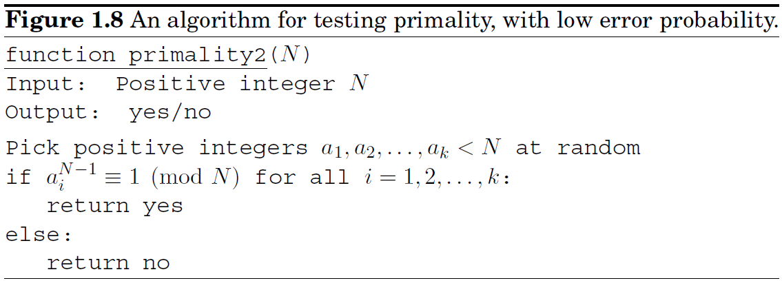
Primality Testing
Pr(Algorithm 1.8 returns yes when ) = 1.
Pr(Algorithm 1.8 returns yes when ) .

Slide 22
Generating Random Primes
Primes are abundant
Lagrange's prime number theorem. Let be the number of primes . Then , or more precisely,
Such abundance makes it simple to generate a random n-bit prime:
Pick a random n-bit number N.
Run a primality test on N.
If it passes the test, output N; else repeat the process.
Time complexity: O(n) rounds
Randomized Algorithms:
Monte Carlo: the error probability can be bounded, polynomial time.
Las Vegas: always get the correct solution, expected polynomial time.

Slide 23
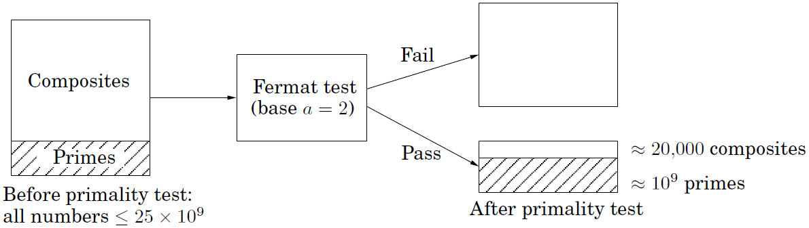
Generating Random Primes
Such abundance makes it simple to generate a random n-bit prime:
Pick a random n-bit number N.
Run a primality test on N.
If it passes the test, output N; else repeat the process.
This is a Monte Carlo randomized algorithm.
Pr[the output of the algorithm is really prime]:

Slide 24
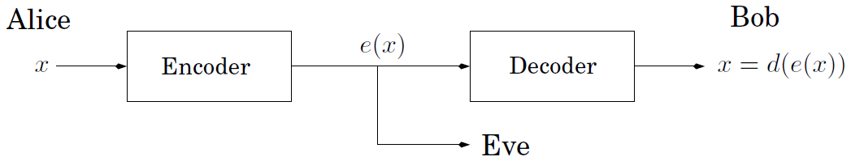
Cryptography
Cryptography: Encode and Decode
Private-key protocols: Alice and Bob meet beforehand and together choose a secret codebook.
Public-key protocols: No need to meet in advance. Bob makes public his encryption function e(x), but not the decryption function d(x).
Martin E. Hellman and Whitfield Diffie introduced the ideas of public-key cryptography and digital signatures in 1976. They were awarded the ACM's 2015 A.M. Turing Award.

Slide 25
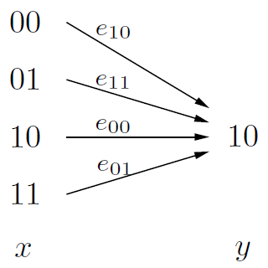
Private-key protocols— One-time PAD
Alice and Bob meet beforehand and secretly choose a random binary string r of the length n.
Safe?
If reused:
it reveals whether the two messages begin or end the same

Slide 26
Cryptography—RSA
RSA: 1977, Ronald L. Rivest, Adi Shamir, Leonard M. Adleman. The most famous public-key protocols. 2002 Turing Award.
Think of messages as numbers modulo N; messages larger than N can be broken into smaller pieces. The encryption function will be a bijection on {0,1,…,N-1}, and the decryption function will be its inverse.
Property. Pick any two primes p and q and let N = pq. For any e relatively prime to (p-1)(q-1):
1. The mapping is a bijection on {0,1,…,N-1}.
2. let modulo (p-1)(q-1). Then
Proof. Because e is relatively prime to (p-1)(q-1), it is invertible. Let
That is . So , such that .
Using Fermat's little theorem,

Slide 27
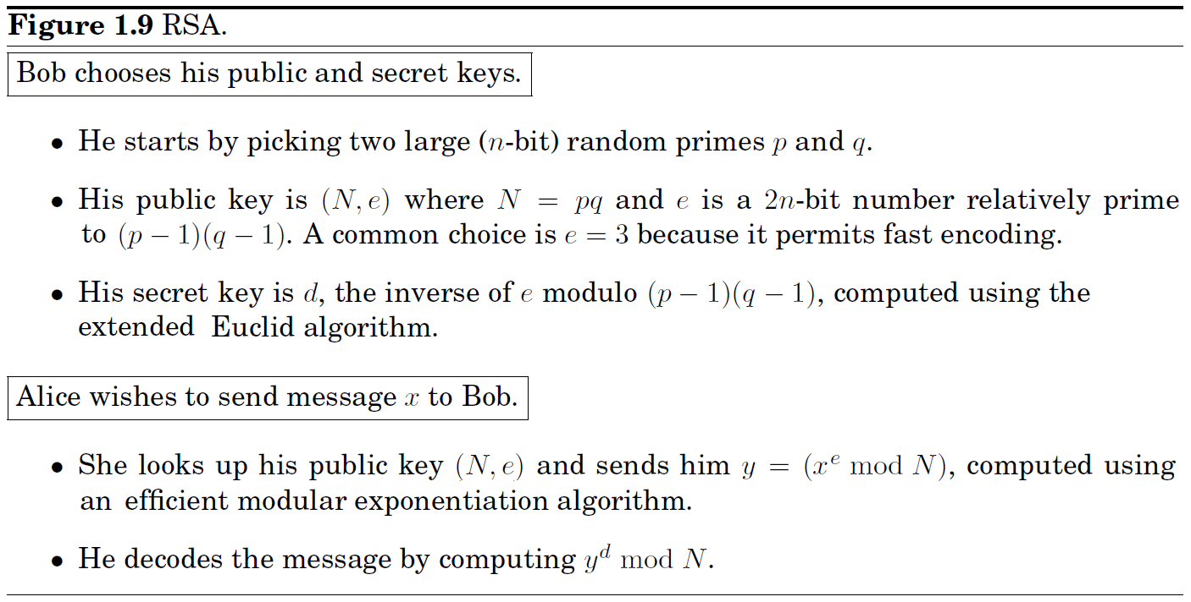
Cryptography—RSA
The security of RSA hinges upon a simple assumption:
Given N, e, and y = x^{e} (mod N), it is computationally intractable to determine x.

Slide 28
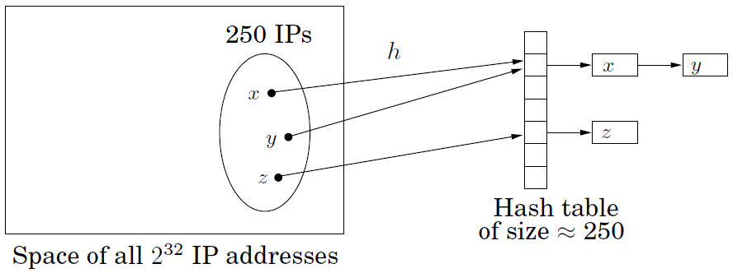
Universal hashing
Problem: Store an unknown set of |S|=m keys.
Mapping keys from U into n bins ([n]={0,…,n-1}, few collisions.
Any deterministic hash function:
not allow for rehashing.
if |U|>mn, facing an adversary, will fail.
Universal hashing. Pick a hash function randomly from a universal family:
Mainly used for hashing integers, vectors, strings
Notes:
any two keys of the universe collide with probability at most 1/m when the hash function h is drawn randomly from H

Slide 29
Universal hashing
Universal hashing for integers
choose a prime n as the table size (a little larger than expected).
let |U| = n^{k} (overestimate is OK).
view each key as a k-tuple of integers modulo n (x₁,…,x_{k}).
Universal hashing for IP
n=257
|U|=257⁴>2³²=256⁴
192.168.0.1
h(x)=(87x₁+23x₂+125x₃+4x₄)mod 257

Slide 30
Universal hashing
Property Two distinct IP: x = (x₁,…,x₄), y = (y₁,…,y₄). Chose a = (a₁,a₂,a₃,a₄) uniformly at random from {0,1,…,n-1}, then
Proof Since , assume w.l.o.g. . Want to compute the probability
Pick a = (a₁,a₂,a₃,a₄) at random. Draw a₁,a₂,a₃, then pause and think: What is the probability that the last drawn number a₄ is such that equation (1) holds? So far the left-hand side of equation (1) evaluates to some number, call it c. Since n is prime and , (y₄-x₄) has a unique inverse modulo n. Thus for equation (1) to hold, the last number a₄ must be precisely c(y₄-x₄)⁻¹ mod n, whose probability is 1/n.

